Slide 1
Continuing the Success of Abenomics
Presentation by Koichi Hamada
Special Advisor to the Cabinet, Japan,
Aichi University, September 4, 2014

Slide 2
Caveat
I will present my own personal views here that is independent of the current policy positions of the Japanese government.

Slide 3
PBFEAM
Accounting
(1) in my life,
(2) as a cradle of an asymmetric information,
(3) as a part of government reform.
Kazuo Sato as my mentor.

Slide 4
Three Arrows
Motonari Mohri, Daimyo of Chugoku District where the Prime Minister was born, gave an arrow to each of his children asked told them to break it which they did easily. He then told them to tie the arrows together and try to break them, --- it was difficult --- thereby demonstrating that “cooperation” would make the bond stronger.
And so the “three arrows” of Abenomics are meant to work in co-operation. They are:
(1) Bold monetary policy;
(2) Flexible fiscal policy; and
(3) Strategies to promote growth.

Slide 5
Relationship between the Arrows
Arrows are not necessarily parallel, but connected by structural relationships:
(1) Monetary policy, the first arrow, is effective when deflation and the high yen leave excess capacity in the economy. This arrow already hit the bull’s eye!
  The asset markets, stock and the yen immediately responded.
  Monetary ease was successful through real balance effect, portfolio rebalance (Tobin’s q) and acceleration effect in the credit channel.
  Already it is working effectively through to goods, and labor market.
  High economic growth rate of 4.1% (1st quarter), 3.8% (2nd quarter) and improvement of labor (offers/applicants) ratio to over 0.9 are indications of success. <Display 1 and 2>

Slide 6
Important to note
(1)The first arrow is unusable, for example, in the Euro aria.
Mobility of laborand capital can mitigate the difficulties.
Banking Union may be only partially helpful.
(2)The currency war under the flexible rates is a fallacy!

Slide 7
The First and Second Arrows (continued)
As long as there is excess capacity, easy money works even without growth strategy (the third arrow). When the economy hits the level of full employment, then money does not increase output or employment and may trigger inflation.
(2) Fiscal Expenditures, the second arrow, are necessary to maintain the quality of public services. As Robert Mundell shows, however, under the flexible exchange rate, the role of this second arrow is quite limited if not accompanied with accommodative monetary policy.

Slide 8
The Third Arrow
(3) Growth Strategy, the third arrow, will enhance the full employment capacity growth path through structural reforms, technological innovation, TPP (Trans-Pacific Partnership) and corporate tax policy.
Expectations of the the third arrow---Growth Strategy
  The Old Fashioned MITI type Industrial Policy --- No! When Japan operates at the frontier of industries, the government can’t choose the winners.
  Exceptions are when externalities and public goods exist. There is a strong case for the carbon tax.
  Mainly, growth strategy is hidden in competition and markets ---along the Koizumi-Takenaka regulatory reform lines.

Slide 9
From Wishful Thinking to
What Government Can unDo Now
To encourage investment in the Japanese economy, rather than “wishing to the stars”, consider what the government can do right now, for example:
(i) Deregulate,
(ii) Participate in the TPP, and
(iii) Reduce the corporate tax burden, or introduce the system to encourage investment such as accelerated depreciation, and a longer loss-offsetting period.
The pursuit of the third arrow without the first may be even deflationary.

Slide 10
Appendix: Regarding Tax Competition of Reducing Corporate Taxes
Government has a large deficit, playing a “civilized” Ponzi game. But the Ministry of Finance highly exaggerates it home and abroad.
The effective corporate tax rate is higher than abroad. (Display 3) In order to survive tax competition, corporate tax burden should be lowered.
Any tax raise will be accompanied by allocative deadweight losses. Among The consumption tax may be the least harmful. However, the right timing of consumption tax hike is important not to suffocate recovery. I raised my reservations but the government decided to go forth because of the recent rapid recovery.
As long as monetary policy through exchange and stock market is effective, I hope the recessionary effect of the hike will be limited.

Slide 11
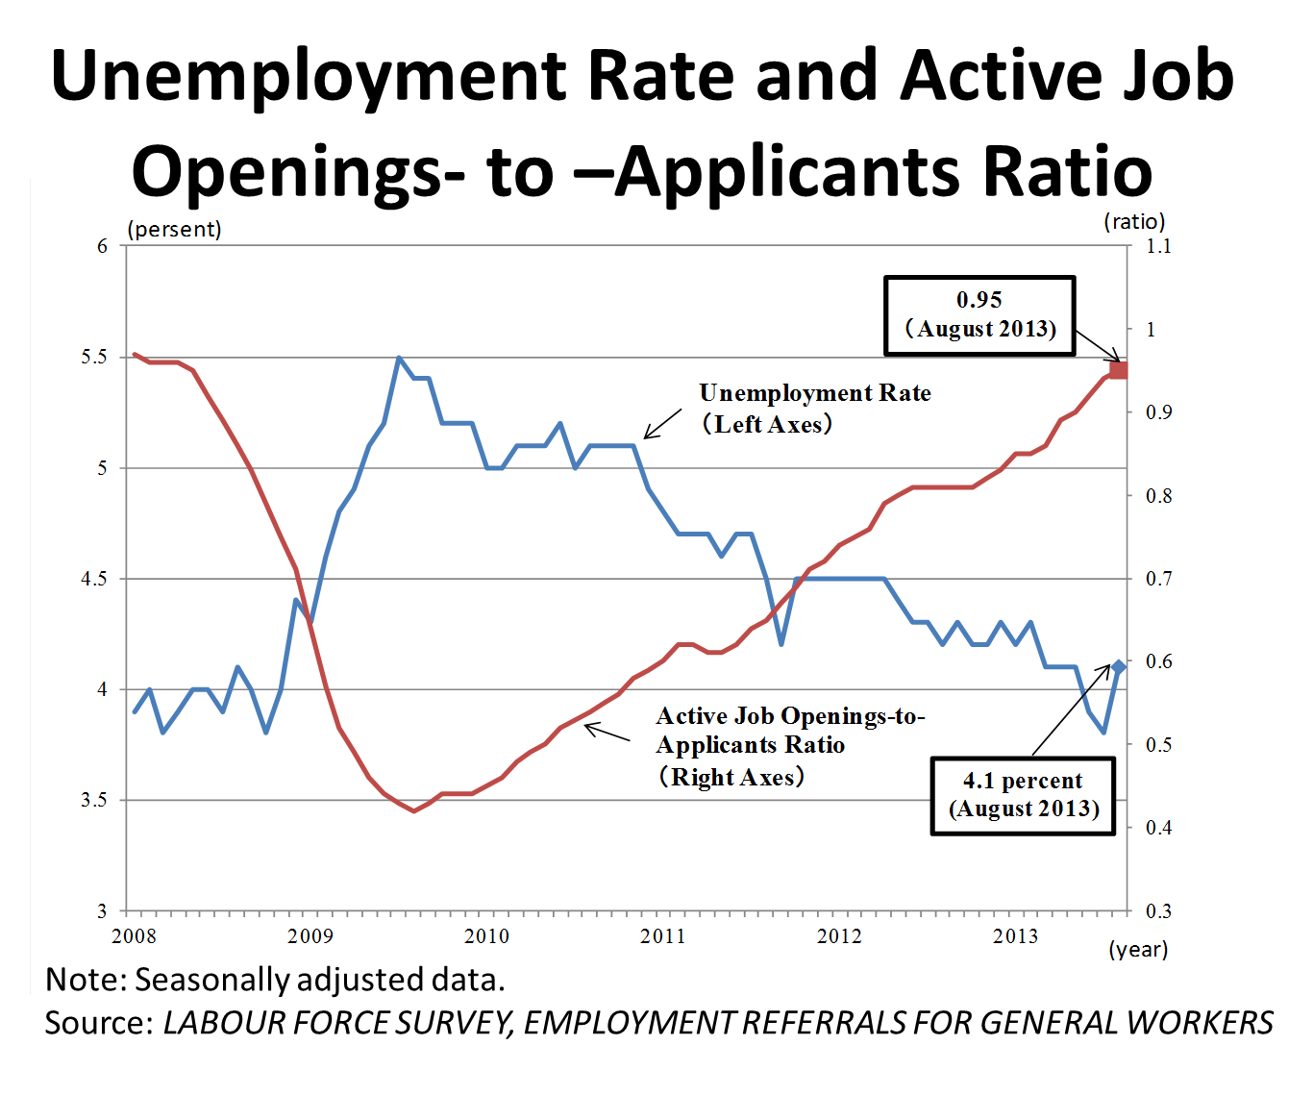

Slide 12
International Comparison of The Effective Corporate Tax Rate (January,2013)
Source: Ministry of Finance Japan Data(Japanese Only)
（http://www.mof.go.jp/tax_policy/summary/corporation/084.htm）

Slide 13
Deflation Gap
Source: Cabinet Office, Topics of Economic Indicators(Japanese only)
http://www5.cao.go.jp/keizai3/shihyo/2013/0912/1079.html

